Slide 1

Code Review
Caroline Wilson
CS-499

Slide 2
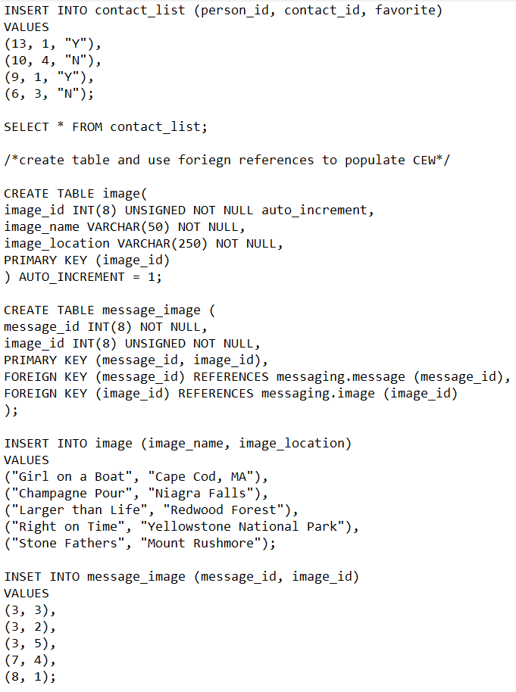
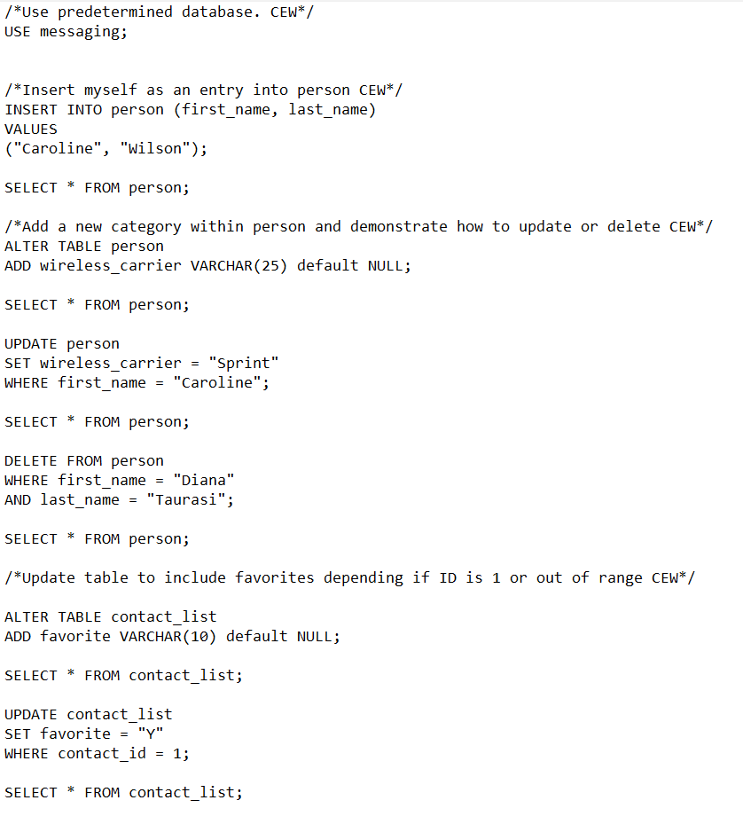
SQL Database Management

Slide 3
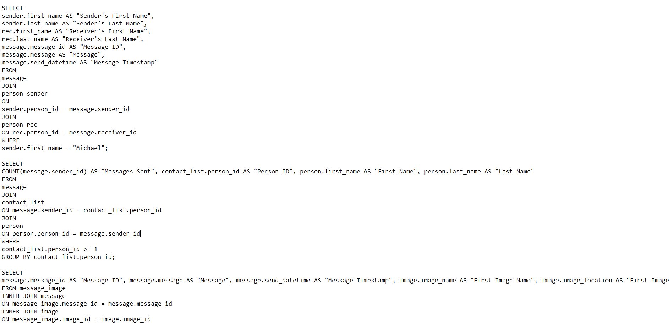
SQL Database Management Continued

Slide 4
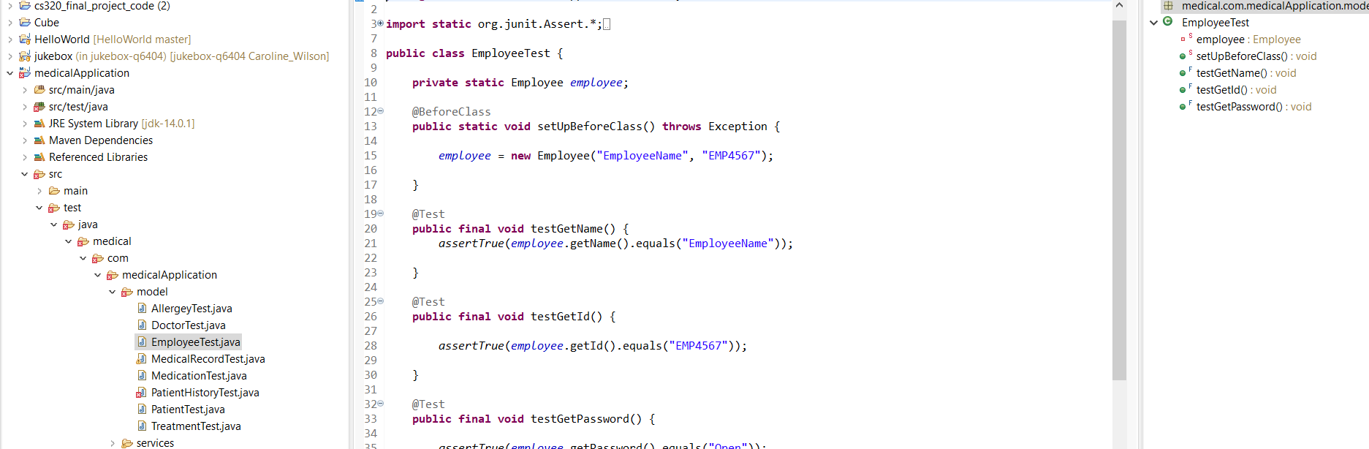
JAVA and Maven Testing

Slide 5
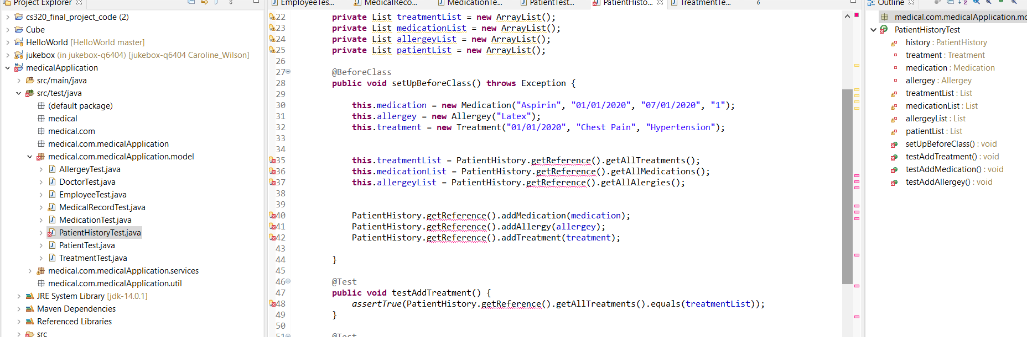
JAVA and Maven Testing Continued

Slide 6
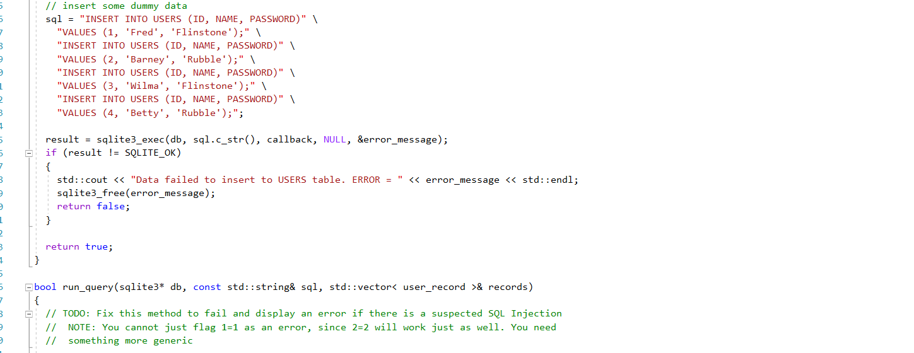
C++ Secure Coding

Slide 7
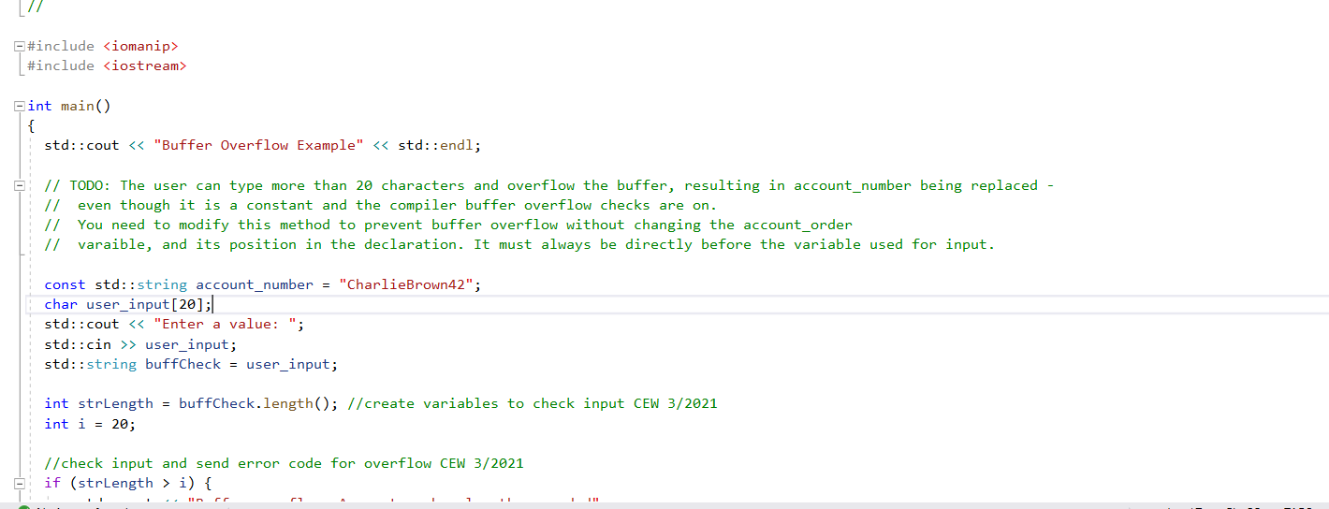
C++ Secure Coding Continued

